Slide 1
A Dash of .NET
Visual Studio Custom IntelliSense, ChatGPT AI Companion extensions, and a few tips…

Slide 2
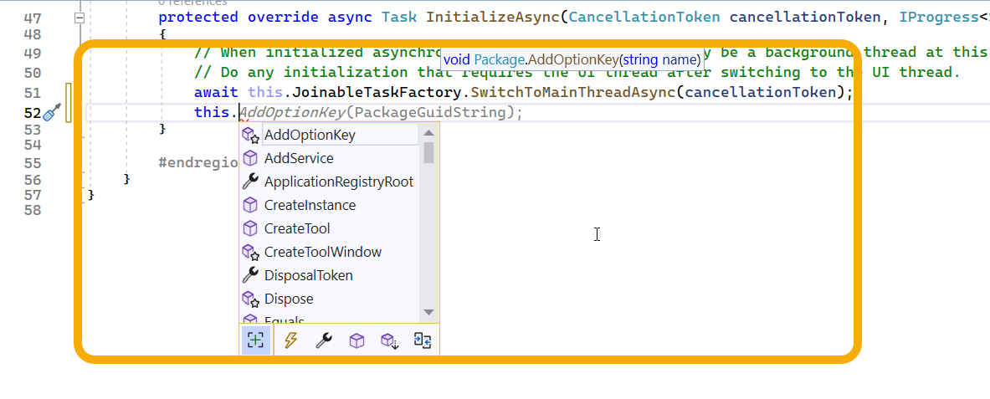
Quick Introduction - Visual Studio IntelliSense

Slide 3
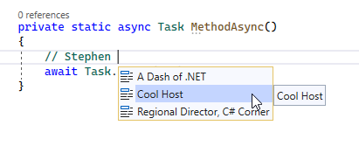
What will we be developing?
Custom Comment Auto-completion

Slide 4
IntelliSense Under the hood (Simplified version)
CompletionSourceProvider
Content Type- C#
MEF
Provides
CompletionSource
Based on context
Completion List
Visual Studio Editor (TextView)
File Type – C#

Slide 5
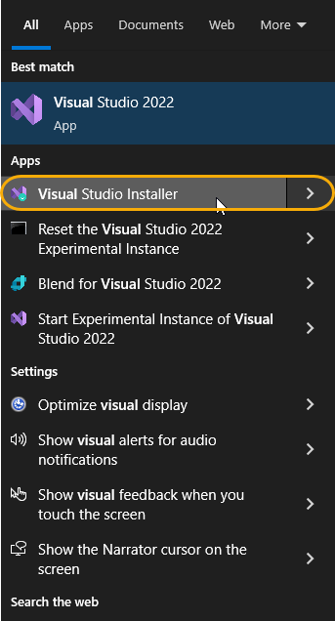
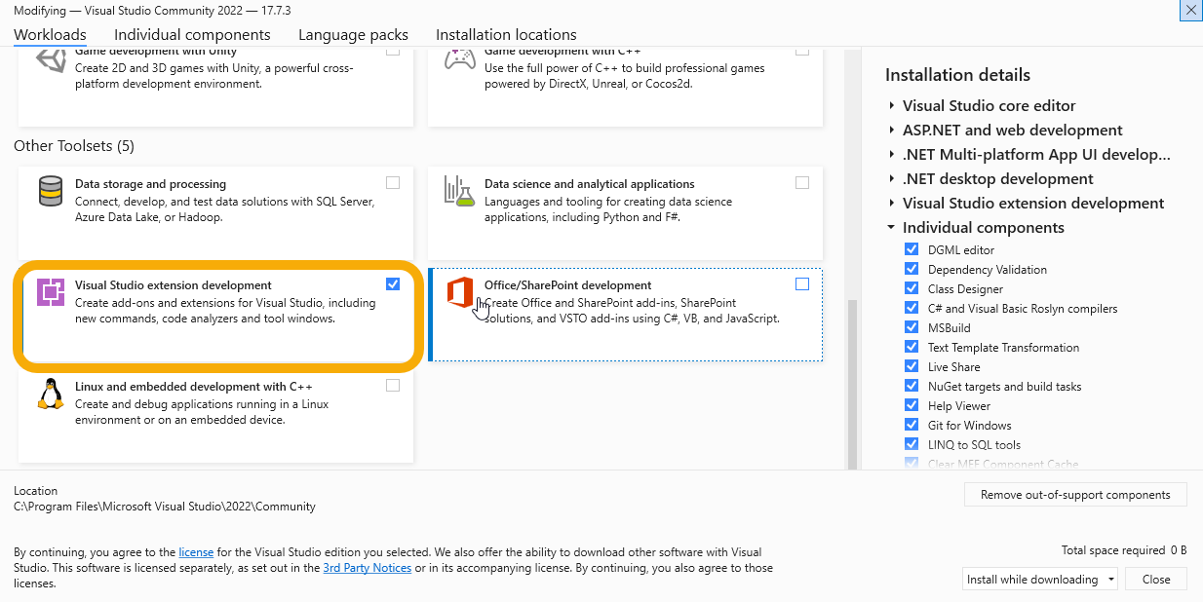
Developing the custom IntelliSense Extension
Click the “Windows button” → Visual Studio Installer → Modify

Slide 6
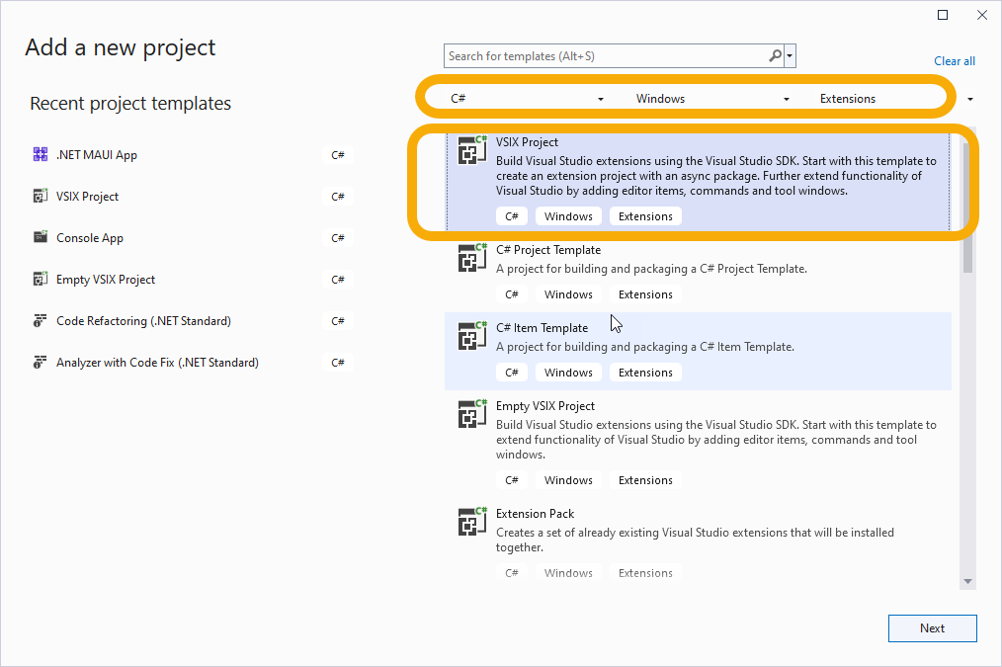
Step 1 – Create a VSIX Project (and update vsixmanifest)

Slide 7
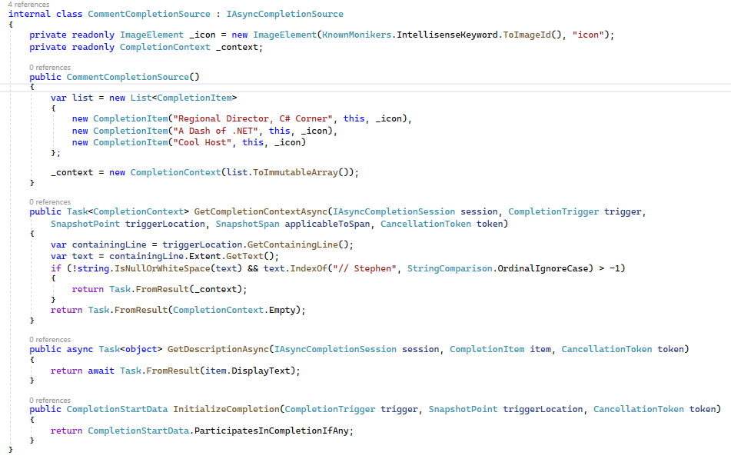
Step 2 – Create a CompletionSource

Slide 8
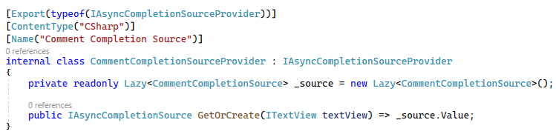
Step 3 – Create a CompletionSourceProvider

Slide 9

Step 4 – Wire up Completion Source to the Package class

Slide 10
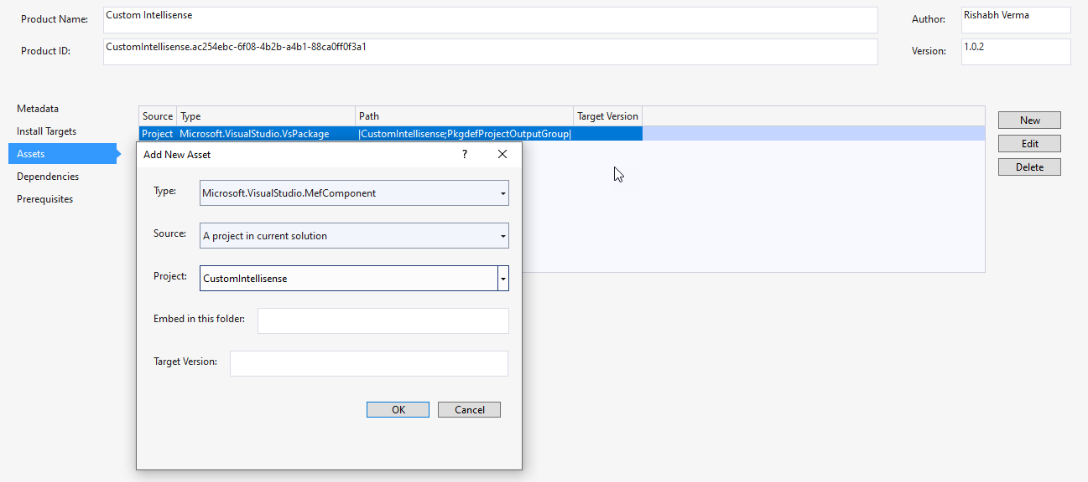
Step 5 – Update Vsixmanifest for the MefComponent
Source Code - https://github.com/Rishabh-V/DashOfDotNet

Slide 11
Run and see it in Action

Slide 12
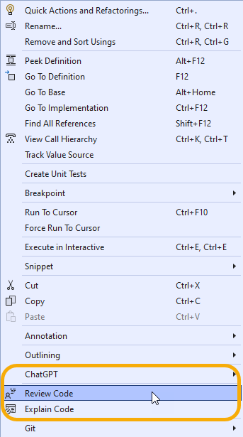
ChatGPT AI Companion for your Development

Slide 13
Step 1 – Create a VSIX Project (and update vsixmanifest)

Slide 14
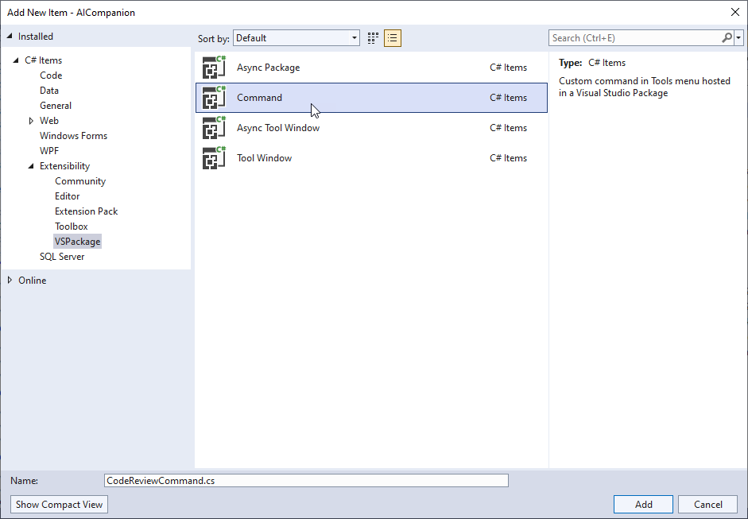
Step 2 – Add commands for Review & Explain

Slide 15
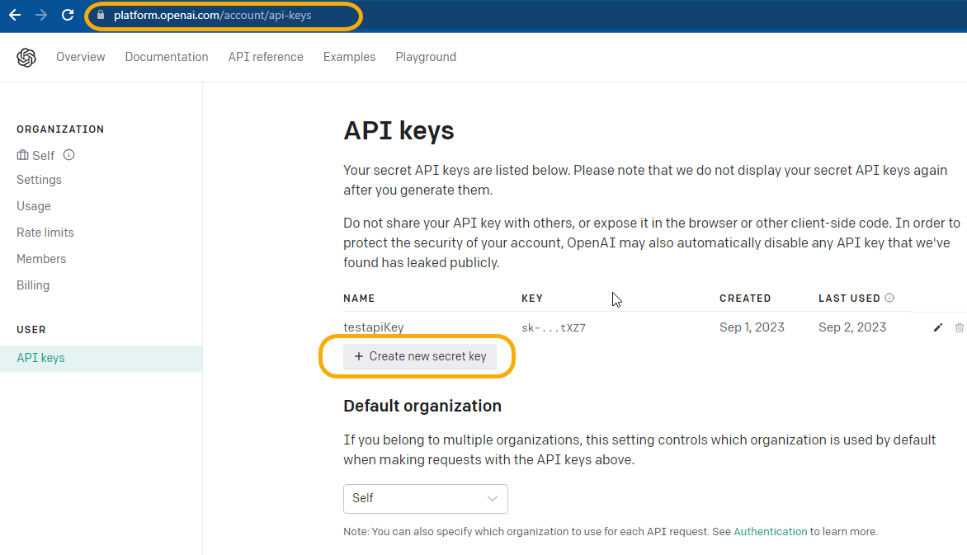
Step 3 – Register with OpenAI API and get the API Key
https://platform.openai.com

Slide 16
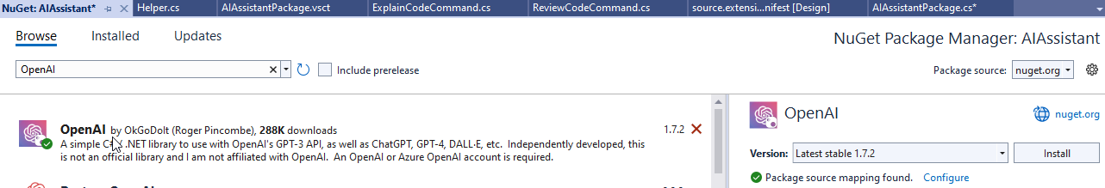
Step 4 – Install OpenAI NuGet Package

Slide 17
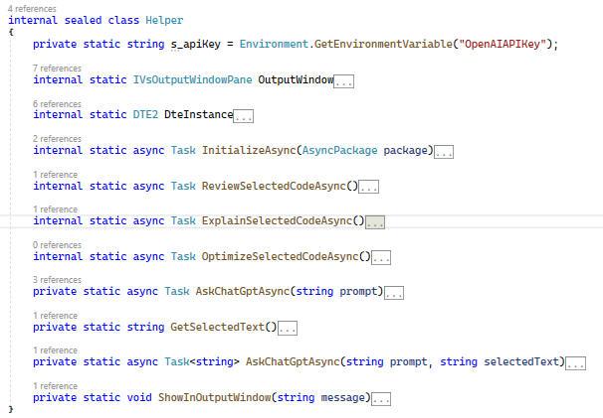
Step 5 – Implement the Helper class to make API calls

Slide 18
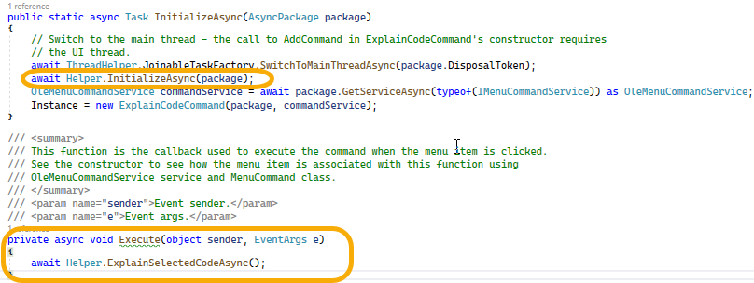
Step 6 – Wire up the Handler and pass the correct Prompt
Source Code - https://github.com/Rishabh-V/DashOfDotNet

Slide 19
Run and see AI Companion in action

Slide 20
Resources & Further Reading
Source Code - https://github.com/Rishabh-V/DashOfDotNet
MEF - https://learn.microsoft.com/en-us/dotnet/framework/mef/
IntelliSense - https://learn.microsoft.com/en-us/visualstudio/ide/visual-csharp-intellisense?view=vs-2022
OpenAI API - https://platform.openai.com/

